Slide 1
Reinforcement Learning in Supply Chain Management

Slide 2
Overview
02
RL in SCM
04
Problem Statement
03
Exisiting Works & gaps
05
Objective Roadmap & Problem Formulation
01
What is SCM ?

Slide 3
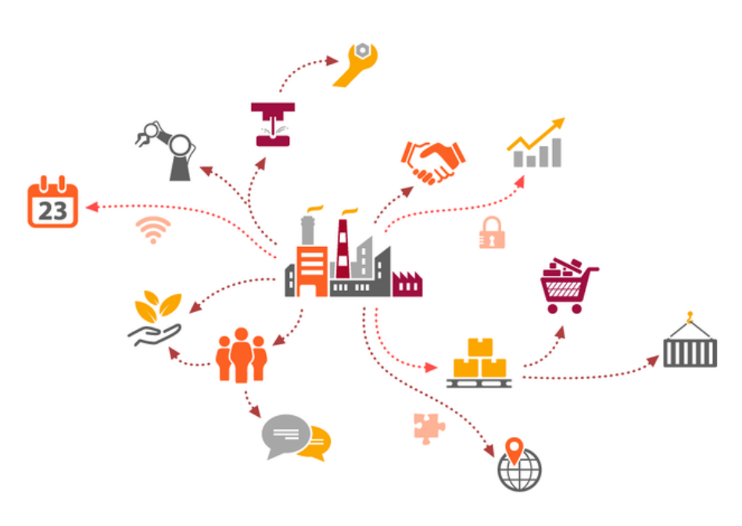

Supply Chain Management
Supply chains are highly complex systems consisting of hundreds if not thousands of manufacturers and logistics carriers around the world who combine resources to create the products we use and consume every day.

Slide 4
Supply Chain Management
• Better ability to predict and meet customer demands
• Fewer process inefficiencies and less product waste
• Improved cash flow and more efficient logistics

Slide 5
Where Reinforced Learning comes in Supply Chain Management ?
Manages demand uncertainty and supply disruptions.
Optimizes across multiple locations and products
RL in SCM
Enhances decision-making in dynamic environments
Reduces Cost of Operation hence increasing profits
Improves overall supply chain performance.

Slide 6
Where Reinforced Learning comes in Inventory Management
Reinforcement learning is developed to solve sequential decision making problems in dynamic environments. In sequential decision making, a series of decisions are to be made in interaction with a dynamic environment to maximize overall reward. This makes reinforcement learning an interesting method for inventory management.
By being able to handle dynamic environments, it can be possible to create a variable policy that is dependent on the current state of the system, instead of a fixed order policy. Sequential decision making and delayed rewards are also relevant for supply chain management.

Slide 7
Literature Review
RL in Supply Chain Management
Manufacturing
Distributions
Warehousing
Transportation
Delivery
Three key studies are examined, each presenting innovative approaches to address specific challenges within the supply chain domain.
Supply Chain Management

Slide 8
Deep Reinforcement Learning toward Robust Multi-echelon Supply Chain Inventory Optimization
2022 IEEE 18th International Conference on Automation Science and Engineering (CASE)
Developed GymSC for multi-echelon supply chain simulation.
Applied deep reinforcement learning for inventory optimization.
DRL outperforms traditional heuristics in dynamic environments.
Demonstrated adaptability to unforeseen, non-stationary customer demands.
Encourages DRL integration into supply chain management research.

Slide 9
A vendor-managed inventory model based on optimal retailers selection and reliability of supply chain
Journal of Industrial and Management Optimization, 2022
VMI model focuses on retailer selection and reliability.
Redundancy allocation problem enhances vendor reliability.
Analytical hierarchical process used for retailer selection.
Genetic algorithm and particle swarm optimization solve model.
Model's effectiveness shown through electronic supply chain case.

Slide 10
A Deep Reinforcement Learning Approach to Supply Chain Inventory Management
arXiv preprint arXiv:2204.09603 (2022).
DRL applied to optimize supply chain inventory management.
Mathematical model for stochastic two-echelon supply chain developed.
Open-source library for DRL algorithm interfacing introduced.
PPO algorithm outperforms VPG and A3C in adaptability.
DRL surpasses traditional reorder

Slide 11
Research Gaps
01
Focus on only Inventory Management ignoring the other components of SCM
02
Scalability
03
Real World Fluctuations in Demand
04
Cost Optimisation across the SCM is not accounted

Slide 12
Problem Statement : Multi-Echelon Supply Chain Management System
Multi-Echelon Supply Chain Management System
We Specifically focus on optimizing returns in a Multi-Echelon Supply Chain Management System, considering factors like Multiple Locations, Transportation, Seasonal Demand, and Manufacturing Costs.

Slide 13
Objective Roadmap
Formulate the Problem as an MDP
Define the
environment
parameters
Train a Deep RL model
on the defined
environment
Create a demand data history
Generate a Baseline to compare against
Compare against the baseline

Slide 14
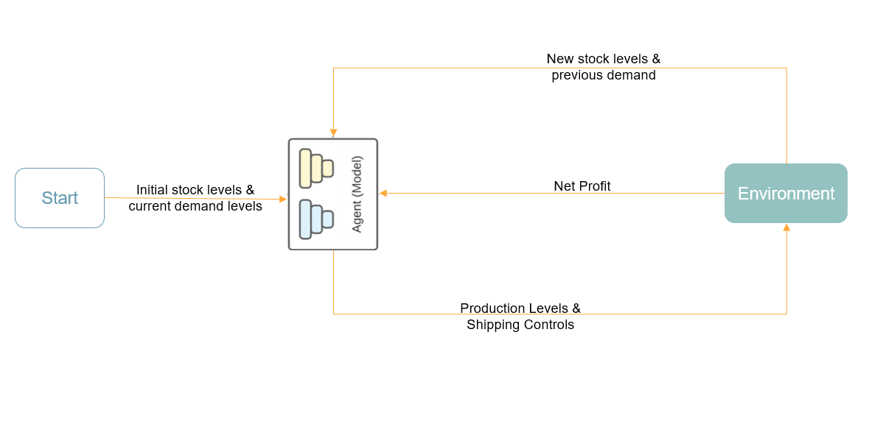
Formulation of problem (MDP) for Reinforcement Learning
The state at time t is the tuple of all current stock levels, and demand values of all warehouses for τ previous steps. The action vector consists of production and shipping control.

Slide 15
Formulation of problem (MDP) for Reinforcement Learning
State = [current stock levels at warehouses, list of demand at distribution warehouses for previous predefined amount of time steps]
Action = [ production level at factory, shipment level to distribution warehouses ]
Reward = Income - expenditure + Penalties = Selling Price * (Total demand) - ( Production Price * (production level) + Storage Costs + Shipment Costs ) + Penalty Cost

Slide 16
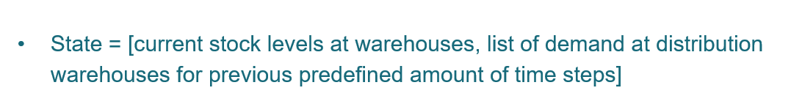
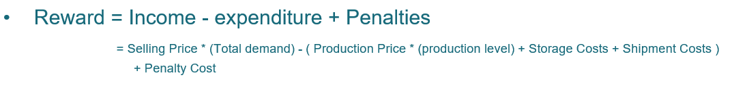
Formulation of problem (MDP) for Reinforcement Learning

Slide 17
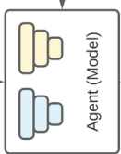
New stock levels & previous demand
Start
Net Profit
Environment
Initial stock levels & current demand levels
Production Levels & Shipping Controls

Slide 18

Thank You

